Slide 1

6th Grade Math
Unit 7, Lesson 3 Adding Integers Using Integer Chips Volume 2, pg. 12

Slide 2


Benchmark
MA.6.NSO.4.1
Apply and extend previous understandings of operations with whole numbers to add and subtract integers with procedural fluency.
volume 2, pg. 12

Slide 3
Integrated Mathematical Thinking and Reasoning Standards
MA.K12.MTR.2.1 Demonstrate understanding by representing problems in multiple ways.
MA.K12.MTR.5.1 Use patterns and structure to help understand and connect mathematical concepts.
volume 2, pg. 12

Slide 4

Learning Targets
I can express integer addition using integer chips.
I can add integers using integer chips.
volume 2, pg. 12

Slide 5

Warm-Up
volume 2, pg. 13

Slide 6
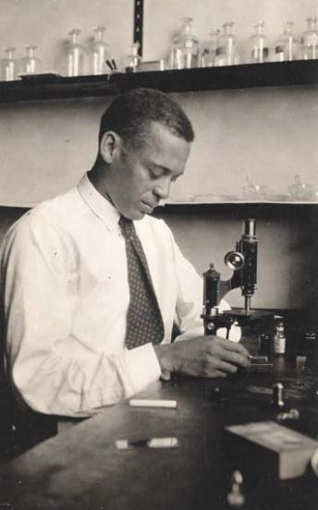
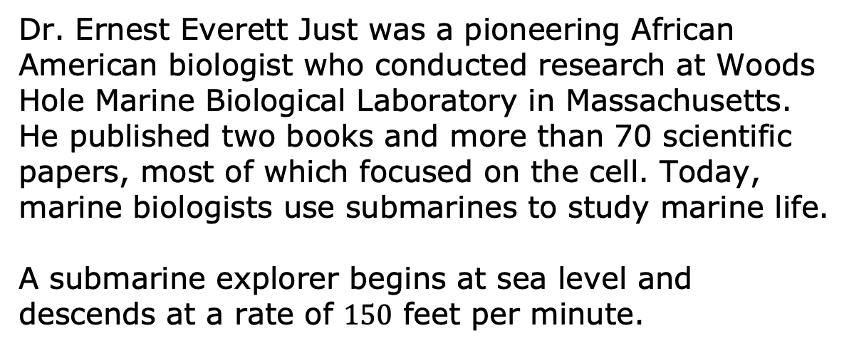
7.3.1 Warm-Up: Below Sea Level
Dr. Ernest Everett Just was a pioneering African American biologist who conducted research at Woods Hole Marine Biological Laboratory in Massachusetts. He published two books and more than 70 scientific papers, most of which focused on the cell. Today, marine biologists use submarines to study marine life.
A submarine explorer begins at sea level and descends at a rate of $150$ feet per minute.
volume 2, pg. 13

Slide 7
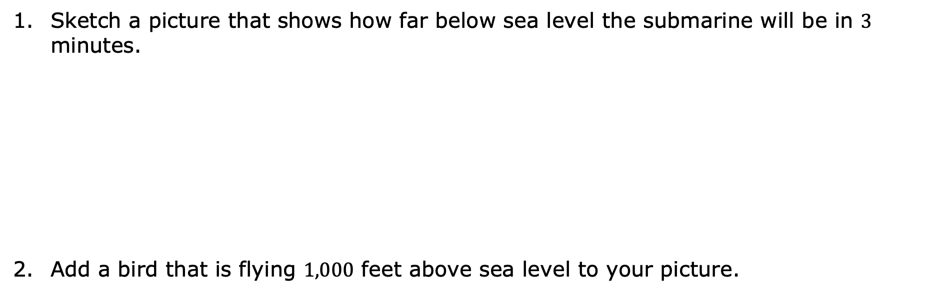
Sketch a picture that shows how far below sea level the submarine will be in $3$ minutes.
Add a bird that is flying $1,000$ feet above sea level to your picture.
volume 2, pg. 13

Slide 8
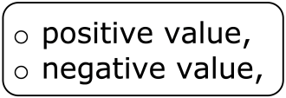
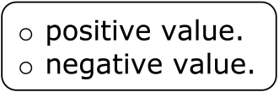
What number represents sea level?
Complete the statement.
The location of the submarine is represented by a
while the location of the bird is
represented by a
volume 2, pg. 13

Slide 9

Guided Instruction
volume 2, pg. 13

Slide 10

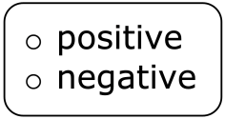
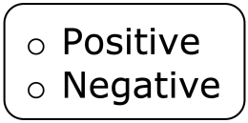
7.3.2 Guided Instruction: Zero Pairs
Positive and negative values are often useful in the contexts of money, banking, and accounting.
In the context of money, numbers
can be used to represent money spent or money
owed to someone.
numbers can be used to represent money
earned.
volume 2, pg. 13

Slide 11


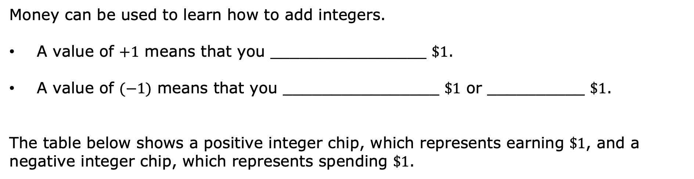
Money can be used to learn how to add integers.
A value of $+1$ means that you ________________ $\$1$.
A value of $(−1)$ means that you ________________ $\$1$ or __________ $\$1$.
The table below shows a positive integer chip, which represents earning $\$1$, and a negative integer chip, which represents spending $\$1$.
Earn | Spend
volume 2, pg. 13

Slide 12

Integer chips can also be used to represent integers.
Integers are whole numbers and their opposites.
volume 2, pg. 13

Slide 13


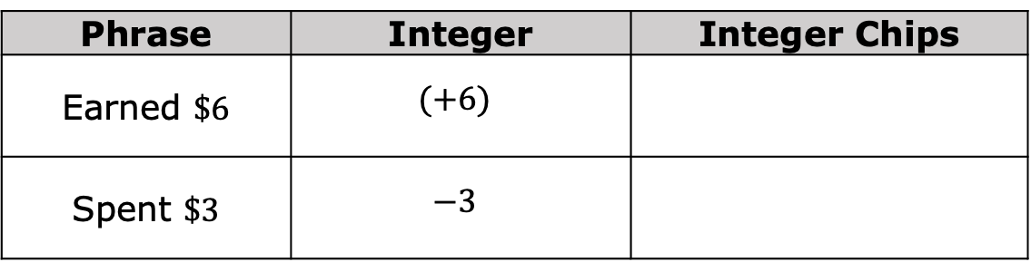
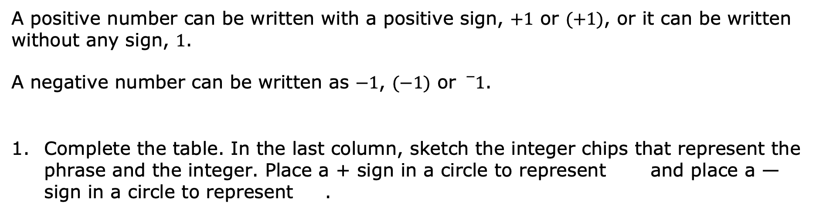
A positive number can be written with a positive sign, $+1$ or $(+1)$, or it can be written without any sign, $1$.
A negative number can be written as $−1$, $(−1)$ or ${}_{}^{−}1$.
Complete the table. In the last column, sketch the integer chips that represent the phrase and the integer. Place a + sign in a circle to represent and place a — sign in a circle to represent .
Phrase | Integer | Integer Chips
Earned $\$6$ | $$(+6)$$
Spent $\$3$ | $$−3$$
volume 2, pg. 14

Slide 14
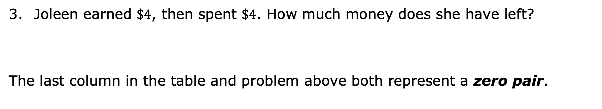
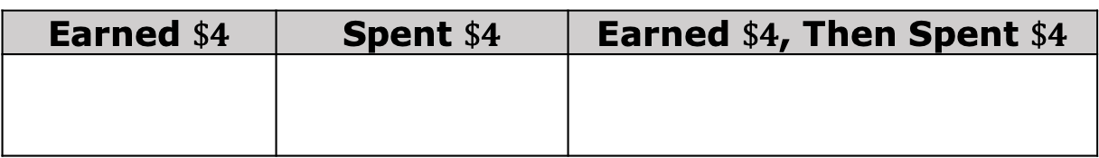
Complete the table by sketching integer chips for each phrase.
Earned $\$4$ | Spent $\$4$ | Earned $\$4$, Then Spent $\$4$
Joleen earned $\$4$, then spent $\$4$. How much money does she have left?
The last column in the table and problem above both represent a zero pair.
A zero pair is a pair of numbers whose sum is zero.
volume 2, pg. 14

Slide 15

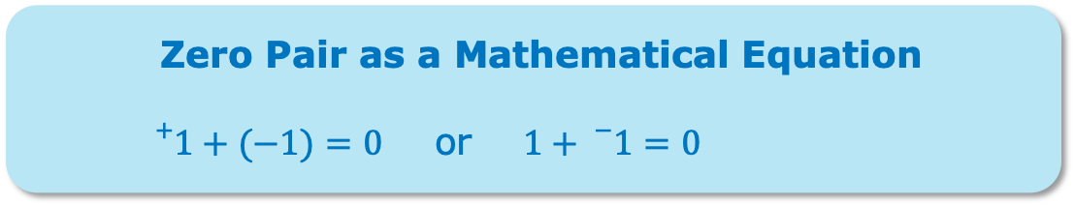
Complete the table by drawing the negative integer chips that create a zero pair. In the sum column, draw all of the chips from both columns.
Positive | Negative | Sum
Each zero pair can be represented by an equation. The box shows two mathematical equations that represent the zero pair of and .
Zero Pair as a Mathematical Equation
${}_{}^{+}{1+(−1)=0}$ or $1+{}_{}^{−}{1=0}$
volume 2, pg. 14

Slide 16
Write an equation that represents the sum column in the previous table.
Complete the table by drawing the positive integer chips that create a zero pair. In the sum column, draw all of the chips from both columns.
Positive | Negative | Sum
Write an equation that represents the sum column in the previous table.
volume 2, pg. 14

Slide 17

Exploration
volume 2, pg. 15

Slide 18


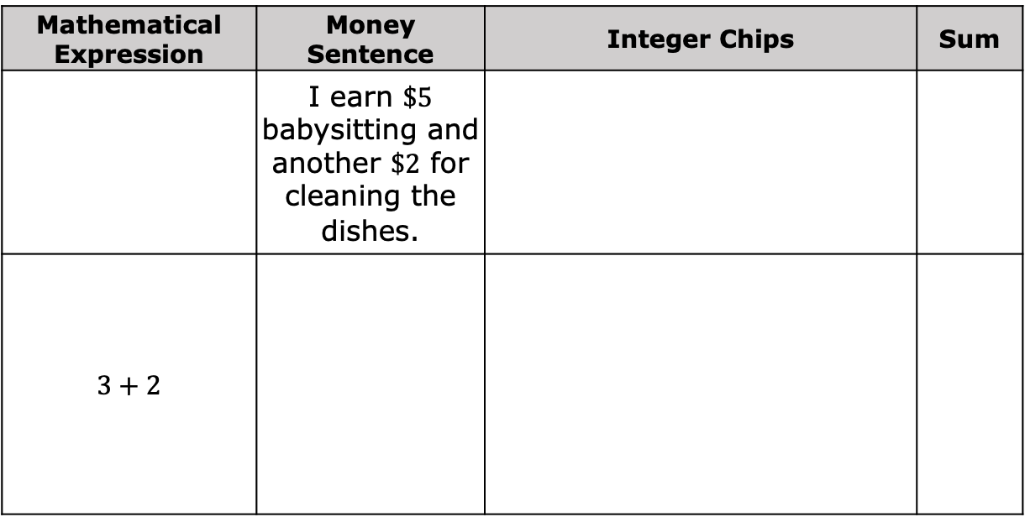
7.3.3 Exploration: Adding Integers with the Same Sign
Work with your partner to complete the table.
Mathematical Expression | Money Sentence | Integer Chips | Sum
 | I earn $\$5$ babysitting and another $\$2$ for cleaning the dishes.
$$3+2$$
volume 2, pg. 15

Slide 19
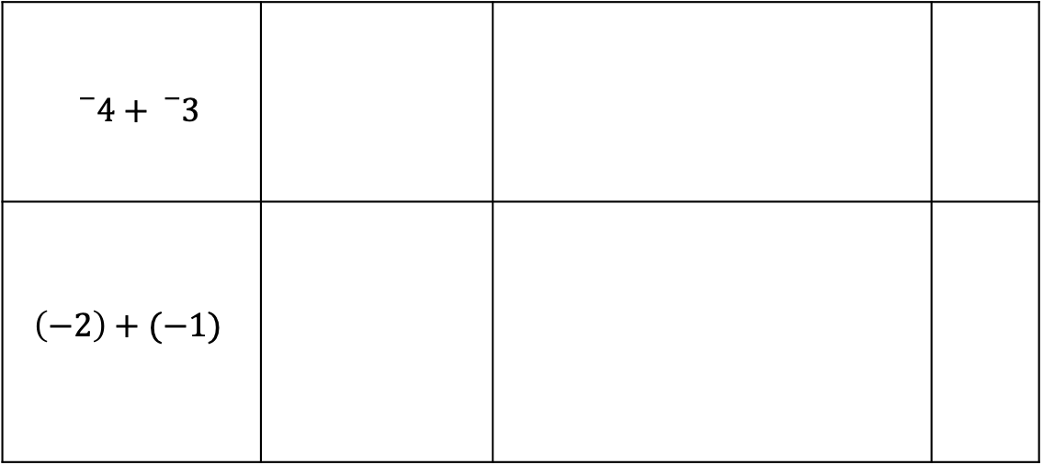
${}_{}^{−}4+{}_{}^{−}3$
$$\left(−2\right)+(−1)$$
With your partner, discuss the patterns you notice about the signs of the sums when adding integers with the same sign.
Were any zero pairs created when adding integers with the same sign? Explain.
volume 2, pg. 15

Slide 20

Bring It Together
volume 2, pg. 15

Slide 21

7.3.4 Bring It Together: Adding Integers with the Same Sign
Complete the visual model of the rule of adding two positive integers by drawing the integer chip that represents the sign of the sum.
Visual Model of Addition | Sign of Sum
Complete the visual model of the rule of adding two negative integers by drawing the integer chip that represent the sign of the sum.
Visual Model of Addition | Sign of Sum
volume 2, pg. 15

Slide 22
Exploration
volume 2, pg. 16

Slide 23


7.3.5 Exploration: Using Zero Pairs to Add Integers with Opposite Signs
It is possible to add a positive number and a negative number. To find the answer using integer chips, combine a and to create a zero pair. Make as many zero pairs as possible. Then, determine the number of chips that are left over.
volume 2, pg. 16

Slide 24
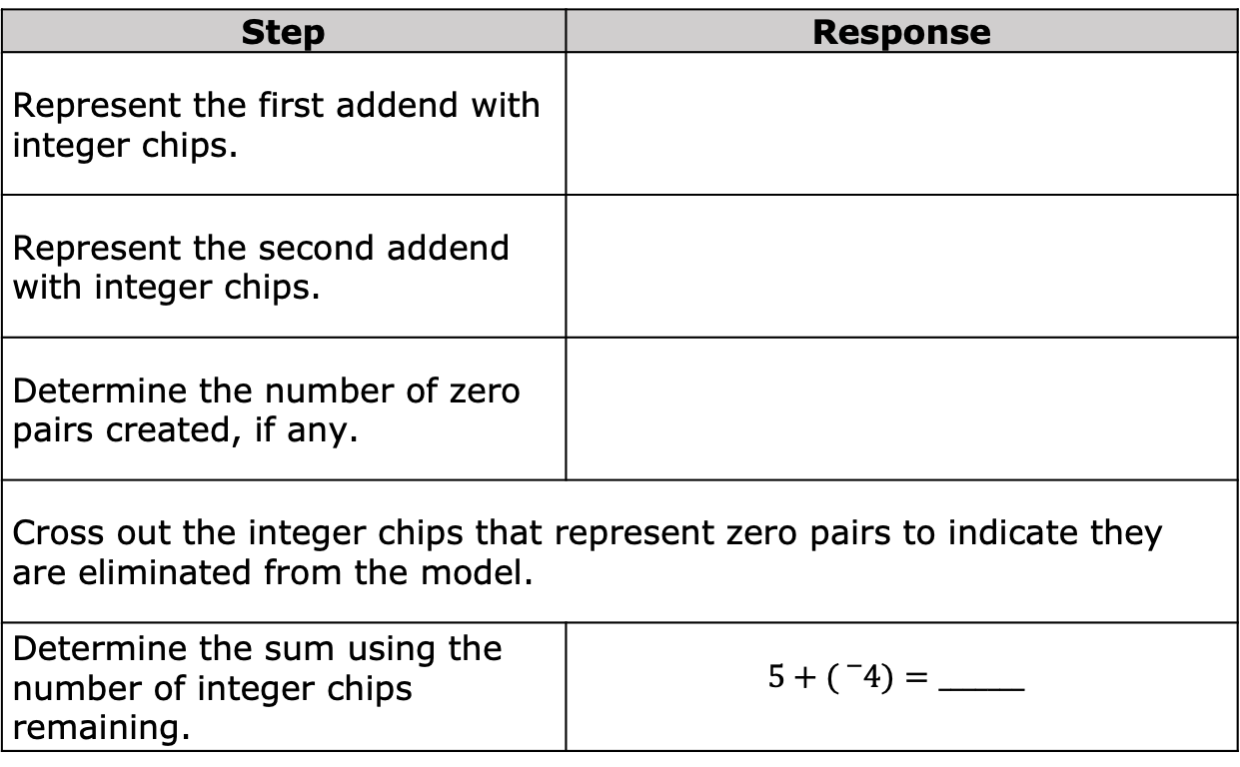
Complete the table to show how the sum $5+\left({}_{}^{−}4\right)$ can be represented using integer chips.
Step | Response
Represent the first addend with integer chips.
Represent the second addend with integer chips.
Determine the number of zero pairs created, if any.
Cross out the integer chips that represent zero pairs to indicate they are eliminated from the model.
Determine the sum using the number of integer chips remaining. | $$5+({}_{}^{−}{4)}=_______$$
volume 2, pg. 16

Slide 25
What do you notice about the remaining integer chips and the sign of the sum?
volume 2, pg. 16

Slide 26


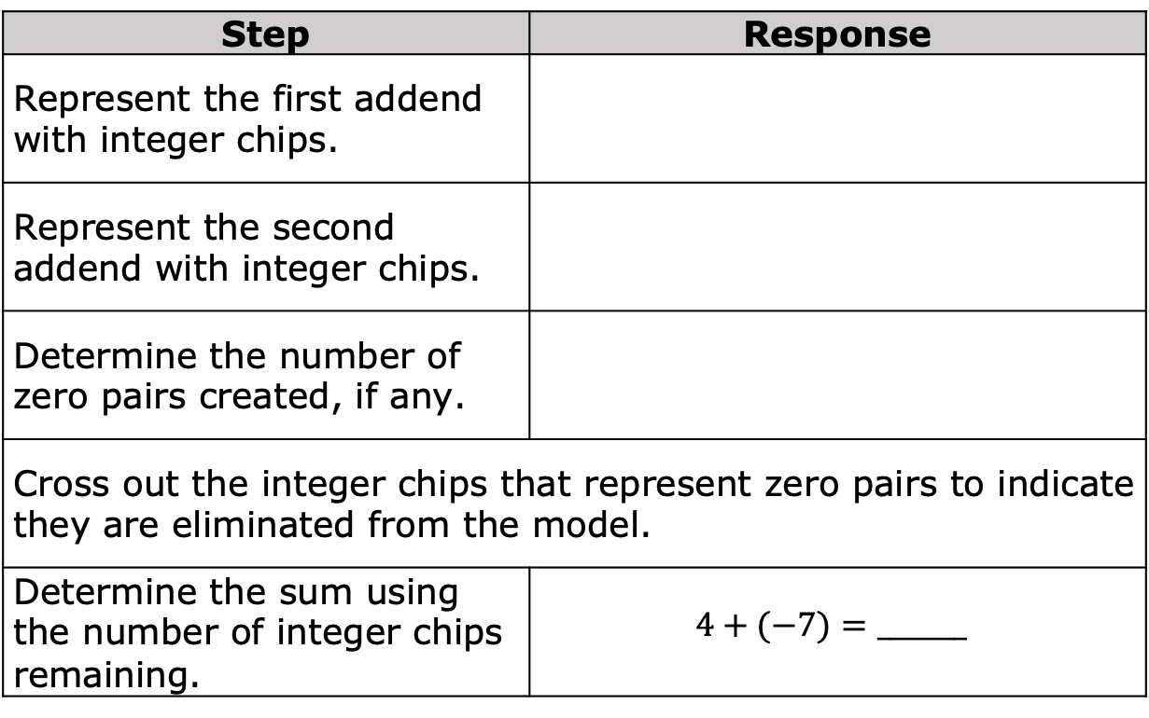
Complete the table independently to show how the sum $4+(−7)$ can be represented using integer chips. Check your work with your partner.
Step | Response
Represent the first addend with integer chips.
Represent the second addend with integer chips.
Determine the number of zero pairs created, if any.
Cross out the integer chips that represent zero pairs to indicate they are eliminated from the model.
Determine the sum using the number of integer chips remaining. | $$4+(−7)=_______$$
volume 2, pg. 16

Slide 27
What do you notice about the remaining integer chips and the sign of the sum?
volume 2, pg. 16

Slide 28

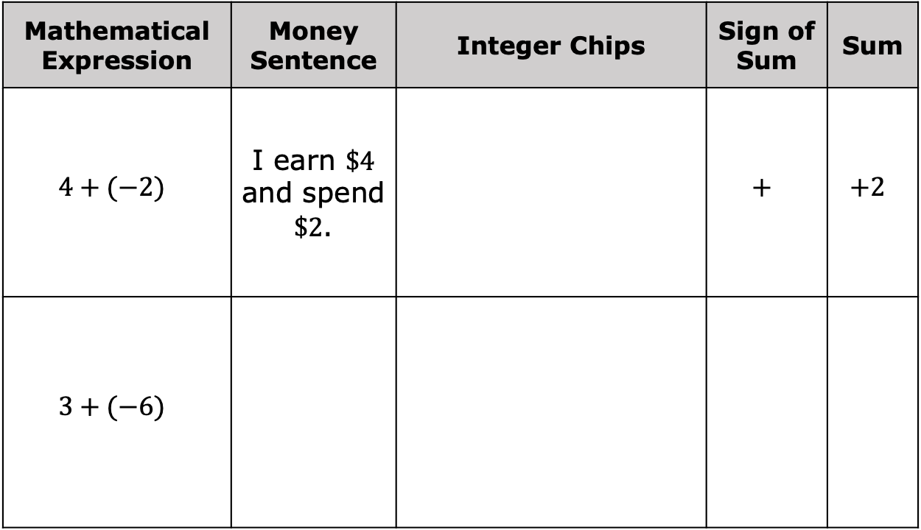
Work with your partner to complete the table. The first row is completed.
Mathematical Expression | Money Sentence | Integer Chips | Sign of Sum | Sum
$$4+(−2)$$ | I earn $\$4$ and spend $\$2$. |  | $$+$$ | $$+2$$
$$3+(−6)$$
volume 2, pg. 17

Slide 29
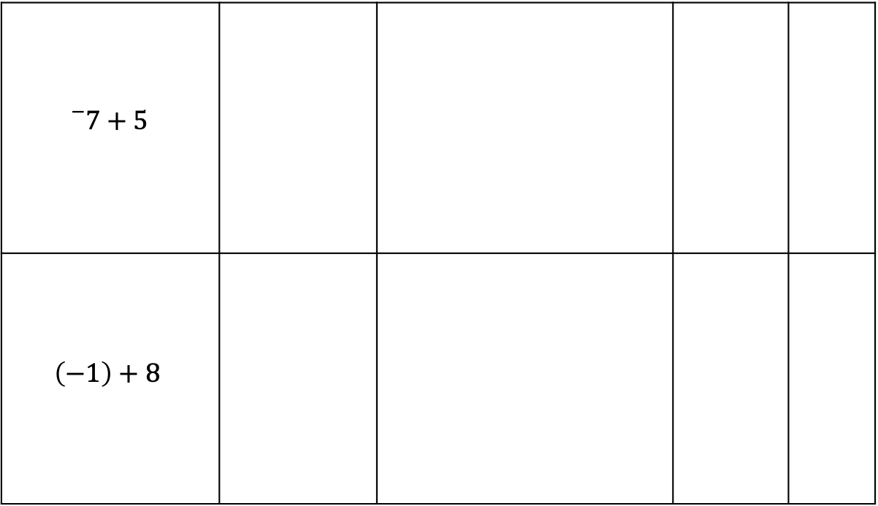
$${}_{}^{−}7+5$$
$$\left(−1\right)+8$$
volume 2, pg. 17

Slide 30
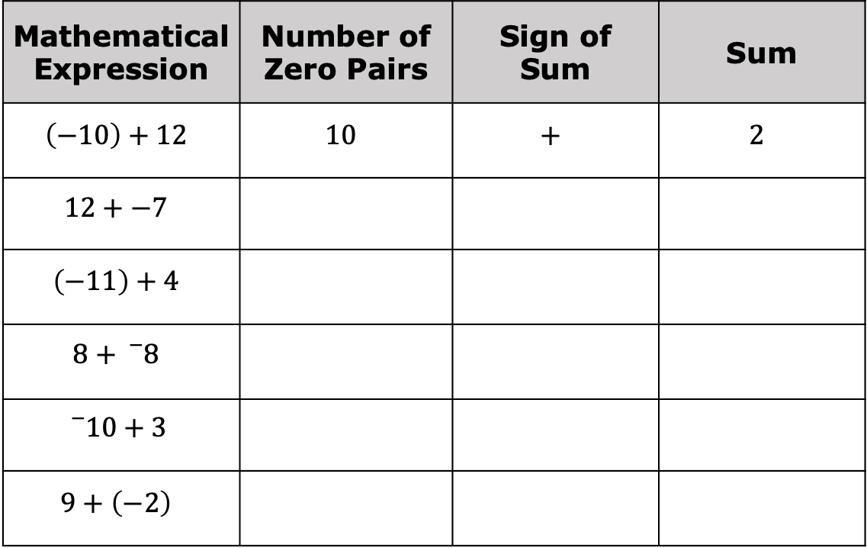
Complete the table below independently. Check your work with your partner.
Mathematical Expression | Number of Zero Pairs | Sign of Sum | Sum
$$\left(−10\right)+12$$ | $$10$$ | $$+$$ | $$2$$
$$12+−7$$
$$\left(−11\right)+4$$
$$8+{}_{}^{−}8$$
$${}_{}^{−}{10}+3$$
$$9+\left(−2\right)$$
volume 2, pg. 17

Slide 31
What do you notice about expressions where the sum is a positive number?
What do you notice about expressions where the sum is a negative number?
volume 2, pg. 17

Slide 32
Bring It Together
volume 2, pg. 18

Slide 33
7.3.6 Bring It Together: Adding Integers with Opposite Signs
The table below shows visual models of rules for adding integers with opposite signs. In each visual model, the larger circle symbolizes the integer represented by the most integer chips.
volume 2, pg. 18

Slide 34
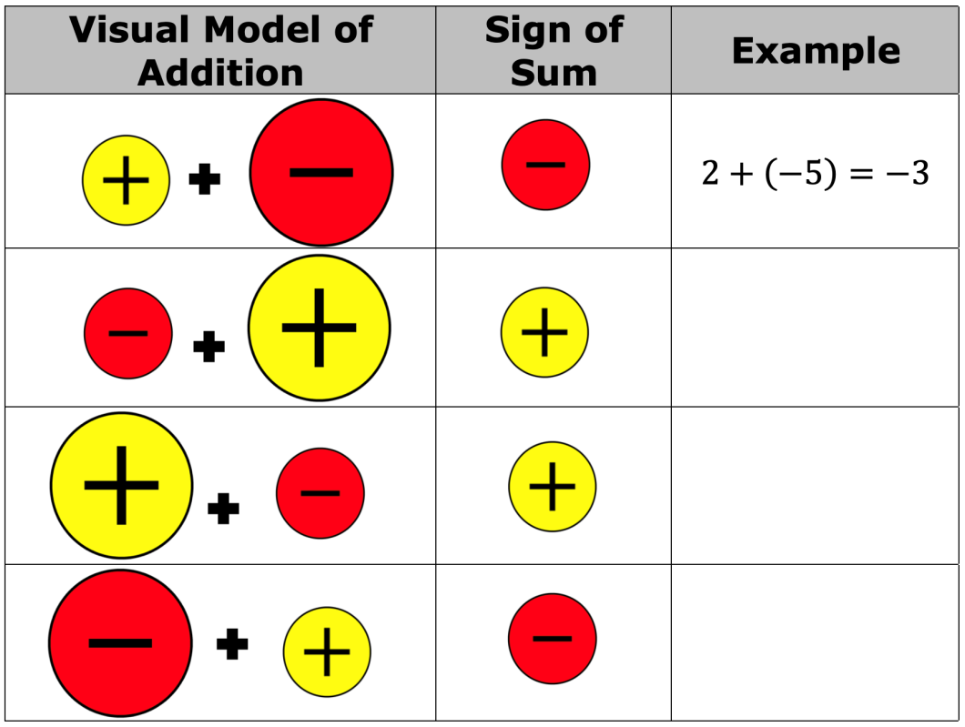
Write an example of the rule. The first row has been completed.
volume 2, pg. 18

Slide 35
Give two observations about the rules for adding integers with opposite signs.
volume 2, pg. 18

Slide 36

Wrap-Up
volume 2, pg. 18

Slide 37
7.3.7 Wrap-Up: Ticket Out the Door
Simone created the sketch below to represent the expression $4+(−3)$.
Her sketch is incorrect. Explain why and create a new sketch to find the sum.
volume 2, pg. 18

Slide 38
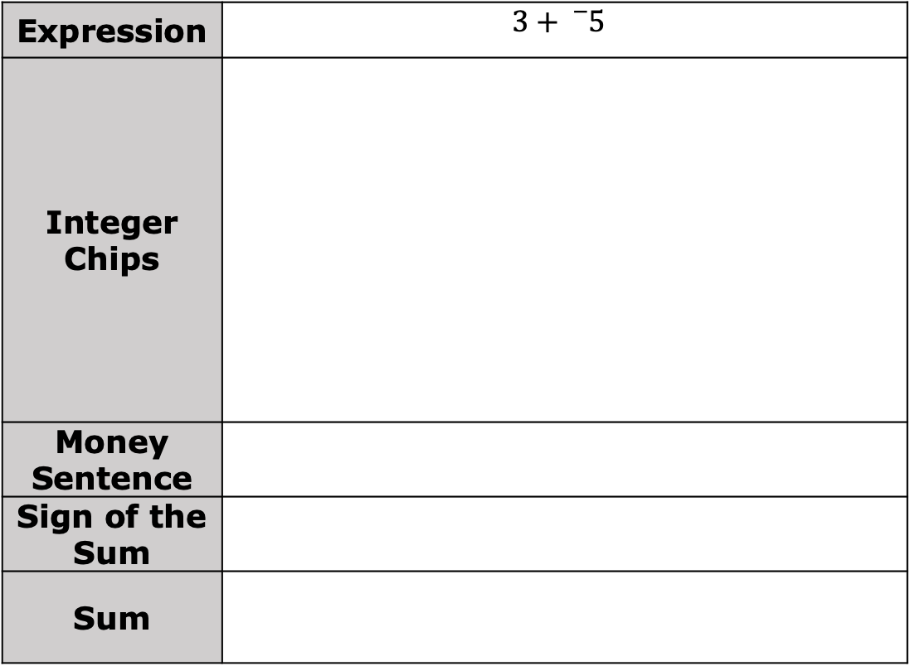
Complete the table for the expression below.
Expression | $$3+{}_{}^{−}5$$
Integer Chips
Money Sentence
Sign of the Sum
Sum
volume 2, pg. 18

